Slide 1
MODULE 4
Cloud in DevOps : Cloud Services and Models, Case study Using AWS in DevOps Information Security: Ethical hacking, Cyber security and information Security, Service Development Life Cycle, Threat Modeling and Risk Management..

Slide 2
CLOUD IN DEVOPS
Cloud computing and DevOps are related in several ways. When DevOps and Cloud Solutions work together in an environment that is built for flexibility and agility, it can be termed as Cloud DevOps.
Cloud computing provides the infrastructure and tools necessary for organizations to implement DevOps practices, while DevOps provides the methodology and culture for organizations to utilize cloud computing effectively.
One of the main ways cloud computing and DevOps are related is through the concept of infrastructure as code.
Cloud computing allows organizations to easily provision and manage their infrastructure through code rather than manually configuring servers and other resources.
This allows for greater automation and scalability, which are key principles of DevOps.
Additionally, cloud computing provides the flexibility and scalability necessary for organizations to implement continuous integration and continuous delivery (CI/CD) pipelines, which are central to DevOps.

Slide 3
Another way in which cloud computing and DevOps are related is through the use of cloud-native tools and services.
For example, many cloud providers offer a wide range of services, such as container orchestration, serverless computing, and monitoring and logging, which can be used to implement DevOps practices.
Additionally, many cloud providers offer pre-built solutions for CI/CD, testing, and monitoring, which can help organizations implement DevOps practices more easily.
Overall, Cloud computing and DevOps have related to providing the infrastructure and tools necessary for organizations to implement DevOps practices.
At the same time, DevOps methodology and culture help organizations to utilize cloud computing effectively.

Slide 4
Three important ways DevOps and cloud work together
Cloud Infrastructure supports DevOps, enabling faster development and scalability.
CloudSecOps combines IT security and operations to protect cloud assets
DevOps as a Service platform enables organizations to set up (CI/CD) pipelines via the cloud without adopting multiple technologies.

Slide 5
1. Cloud is leveraged by DevOps:
Organizations utilizing DevOps manage and automate their infrastructure using Cloud Computing technologies.
This enables them to follow an agile approach to different work processes. DevOps processes are said to be very agile when implemented efficiently, but they can face limitations of an on-premise environment every now and then.
For instance, if an organization needs to start building a new software project or scale up an existing production application, it can cause needless delays and complexity for DevOps teams.

Slide 6
In cases like this, Cloud infrastructure offers an important boost for DevOps.
It minimizes the latency and enables centralized management via a unified platform for deploying, testing, integrating, and releasing applications.
They also offer CI/CD tools to automate DevOps processes.
This enables the DevOps teams to collaborate among each other across distributed enterprise environments along with adapting to the changing requirements.
This high level cloud-based DevOps automation helps minimize human error and streamline repeatable processes and tasks.

Slide 7
2. CloudSecOps (Cloud Security Operations):
SecOps or Security Operations is a collaboration between IT security and IT operations.
It integrates processes, tools and technology to keep an enterprise secure along with reducing any associated risks.
Cloud security operations or CloudSecOps is an evolution of SecOps that aims to identify, respond, and recover systems from attacks targeting an organization’s cloud assets.

Slide 8
CloudSecOps teams have several roles. Some of them are:
Incident management: Identifies security incidents, responds to them, and coordinates the response with legal and communication teams.
Event Prioritization: Prioritizing events based on risk score calculation for cloud systems, accounts, and devices, and identifying cloud data sensitivity.
Threat hunting: Discovering advanced security threats with the help of tools that filter out the noise from security monitoring solutions enabling advanced investigation of data.

Slide 9
3. DevOps as a Service
DevOps as a Service is a set of cloud-based tools that enables collaboration between the development and operations teams of an organization.
This toolset covers all the relevant DevOps processes and provides them as a unified platform where the teams select the tools they want for each purpose.
DevOps as a Service platform enables organizations to set up continuous integration/ continuous delivery (CI/CD) pipelines via the cloud to increase development velocity and provide continuous feedback to the developers.
This way the team can access any relevant technology without having to find, adopt, and learn multiple tools.

Slide 10
Cloud services and models
Cloud computing is basically a collection of different services provided by different companies.
It mainly depends on resource sharing using internet-enabled devices that allow the function of application software.
There are mainly two types of cloud computing models which are service-based and deployment based.

Slide 11
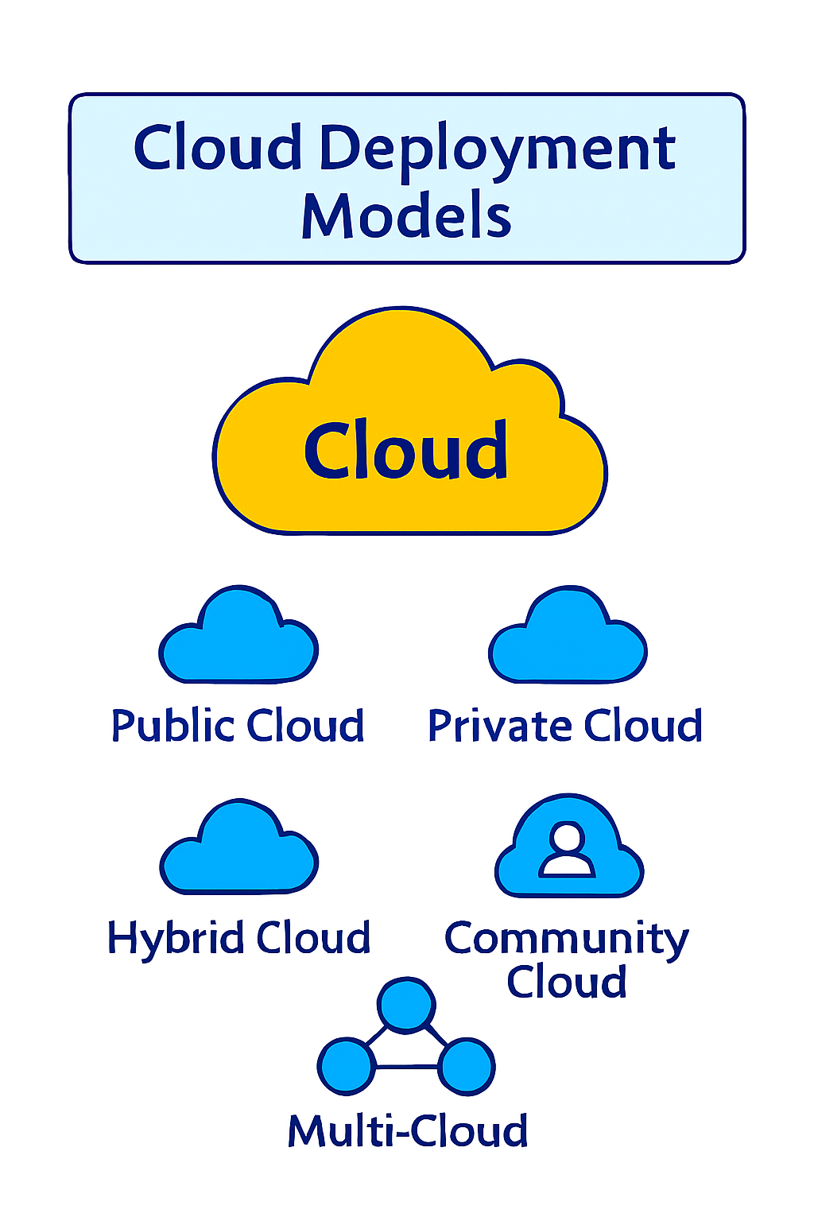
DEPLOYMENT BASED MODELS
Deployment models describe how cloud services are delivered:
Public Cloud Services are offered by third-party providers over the internet. Resources are shared among multiple users. Best for: Startups, scalable workloads, cost-sensitive projects.
Private Cloud Dedicated infrastructure for a single organization, either on-premises or hosted. Provides greater control and security. Best for: Enterprises with strict compliance or data sovereignty needs.

Slide 12
Hybrid Cloud Combines public and private clouds, allowing data and applications to move between them. Offers flexibility and balance. Best for: Organizations needing both scalability and control.
Community Cloud Shared infrastructure among organizations with similar goals or compliance requirements. Best for: Government agencies, universities, healthcare institutions.
Multi-Cloud Uses multiple public cloud providers simultaneously. Helps avoid vendor lock-in and improves redundancy. Best for: Large enterprises seeking resilience and performance optimization.

Slide 13
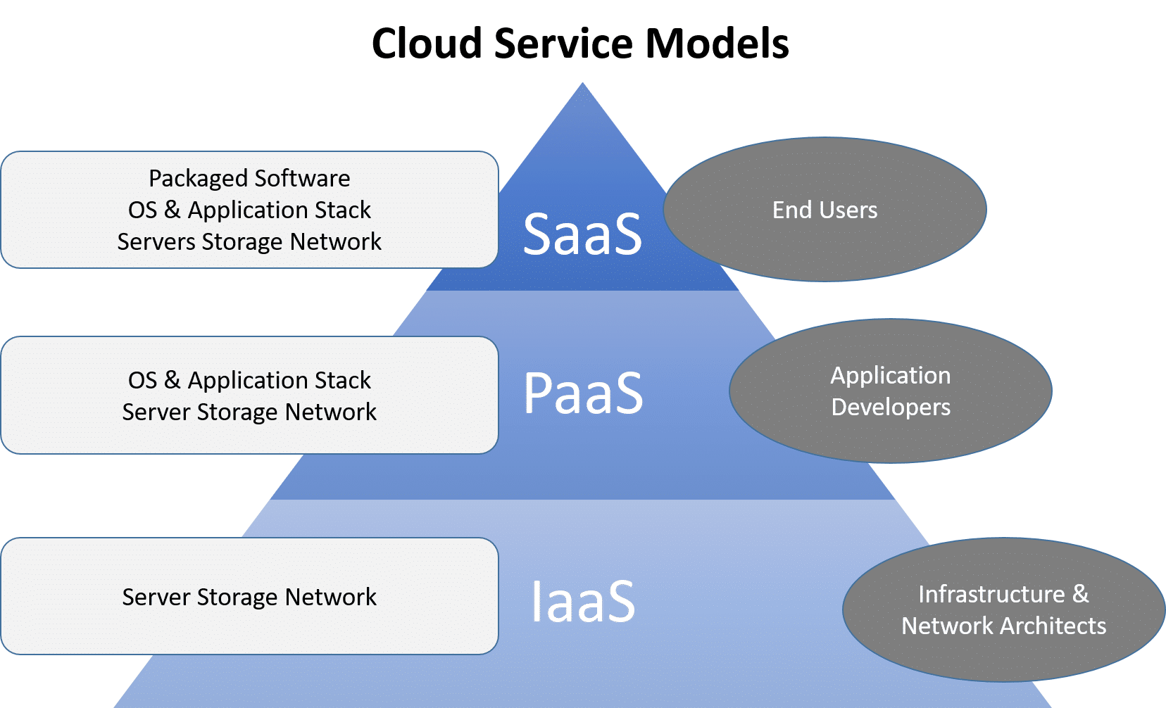
SERVICE BASED MODELS

Slide 14
SaaS(Software as a Service)
SaaS (sometimes called cloud application services) is cloud-hosted,
ready-to-use application software.
Users pay a monthly or annual fee to use a complete application from within a web browser, desktop client or mobile app.
The application and all of the infrastructure required to deliver it - servers, storage, networking, middleware, application software, data storage - are hosted and managed by the SaaS vendor.

Slide 15
Email, social media, and cloud file storage solutions (such as Dropbox or Box)
Popular business or enterprise SaaS solutions include :
Salesforce (customer relationship management software), HubSpot (marketing software), Trello (workflow management), Slack (collaboration and messaging), and Canva (graphics).
Many applications designed originally for the desktop (e.g., Adobe Creative Suite) are now available as SaaS (e.g., Adobe Creative Cloud).

Slide 16
Benefits
✔ No Installation Required – Accessible via browser ✔ Low Maintenance – Provider manages everything ✔ Quick Deployment – Ready to use immediately ✔ Lower Initial Cost – Subscription-based model ✔ Automatic Updates – Always latest version

Slide 17
Disadvantages
Minimal Control – No control over infrastructure or backend
Data Security Concerns – Data stored with provider
Internet Dependency – Requires stable internet connection
Limited Customization – Restricted feature modification
Subscription Costs – Recurring long-term cost

Slide 18
PaaS(Platform as a Service)
The cloud services provider hosts, manages and maintains all the hardware and software included in the platform - servers (for development, testing and deployment), operating system (OS) software, storage, networking, databases, middleware, runtimes, frameworks, development tools - as well as related services for security, operating system and software upgrades, backups and more.

Slide 19
Users access the PaaS through a graphical user interface (GUI), where development or DevOps teams can collaborate on all their work across the entire application lifecycle including coding, integration, testing, delivery, deployment, and feedback.
Examples of PaaS solutions include AWS Elastic Beanstalk, Google App Engine, Microsoft Windows Azure, and RedHat OpenShift on IBM Cloud.

Slide 20
Benefits
✔ Faster Development – No infrastructure setup ✔ Automatic Updates – Platform handles patches & upgrades ✔ Built-in Scaling – Auto-scaling features ✔ Reduced Management – Focus only on code ✔ Developer Friendly – Integrated tools and services

Slide 21
Disadvantages
Less Control – Limited access to underlying system
Vendor Lock-in Risk – Hard to migrate between providers
Limited Customization – Cannot modify OS-level settings
Cost at Scale – Can become expensive for large workloads

Slide 22
IaaS(Infrastructure as a Service)
IaaS customers can choose between virtual machines (VMs) hosted on shared physical hardware (the cloud service provider manages virtualization)
or bare metal servers on dedicated (unshared) physical hardware.
Customers can provision, configure and operate the servers and infrastructure resources via a graphical dashboard, or programmatically through application programming interfaces (APIs).
Every major cloud service provider - Amazon Web Services, Google Cloud, IBM Cloud, Microsoft Azure - began by offering some form of IaaS.

Slide 23
Benefits
✔ High Control – Full control over OS, applications, and configurations ✔ Scalability – Easily scale servers up or down ✔ Cost-effective – No need to purchase physical hardware ✔ Flexibility – Supports any software or platform ✔ Good for DevOps – Ideal for Infrastructure as Code (IaC)

Slide 24
Disadvantages
Requires Technical Expertise – Need knowledge of networking, OS, security
Security Responsibility – You are responsible for securing OS and apps
Management Overhead – Must manage updates, patches, monitoring
Complex Setup – Initial configuration can be complex

Slide 25
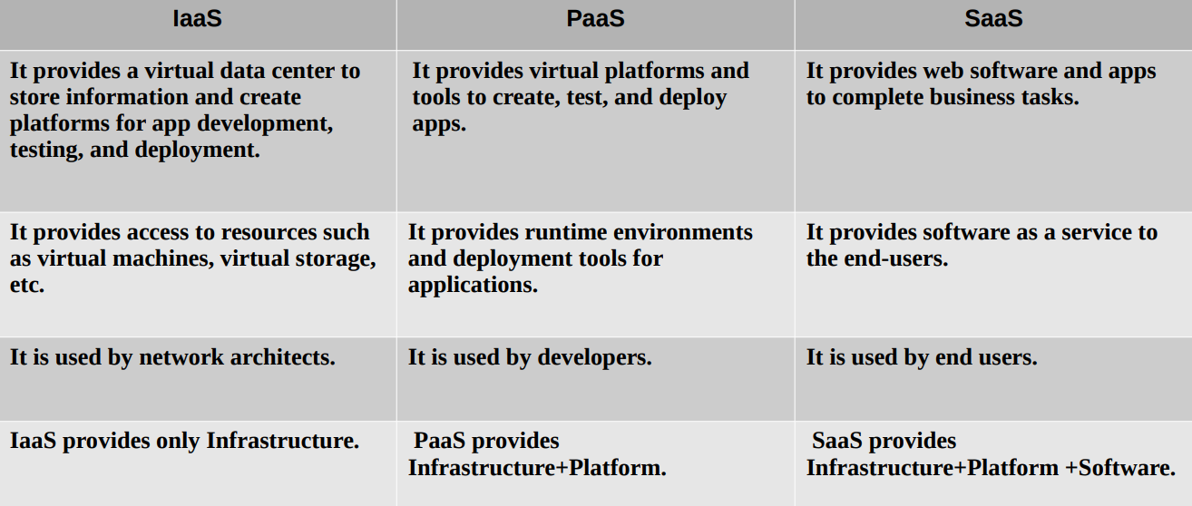

Slide 26
Information Security
Information security (InfoSec) refers to the processes and tools designed and deployed to protect sensitive business information from modification, disruption, destruction, and inspection.
Information Security - The protection of information and information systems from unauthorized access, use, disclosure, disruption, modification, or destruction in order to provide confidentiality, integrity, and availability.
InfoSec is a crucial part of cybersecurity

Slide 27
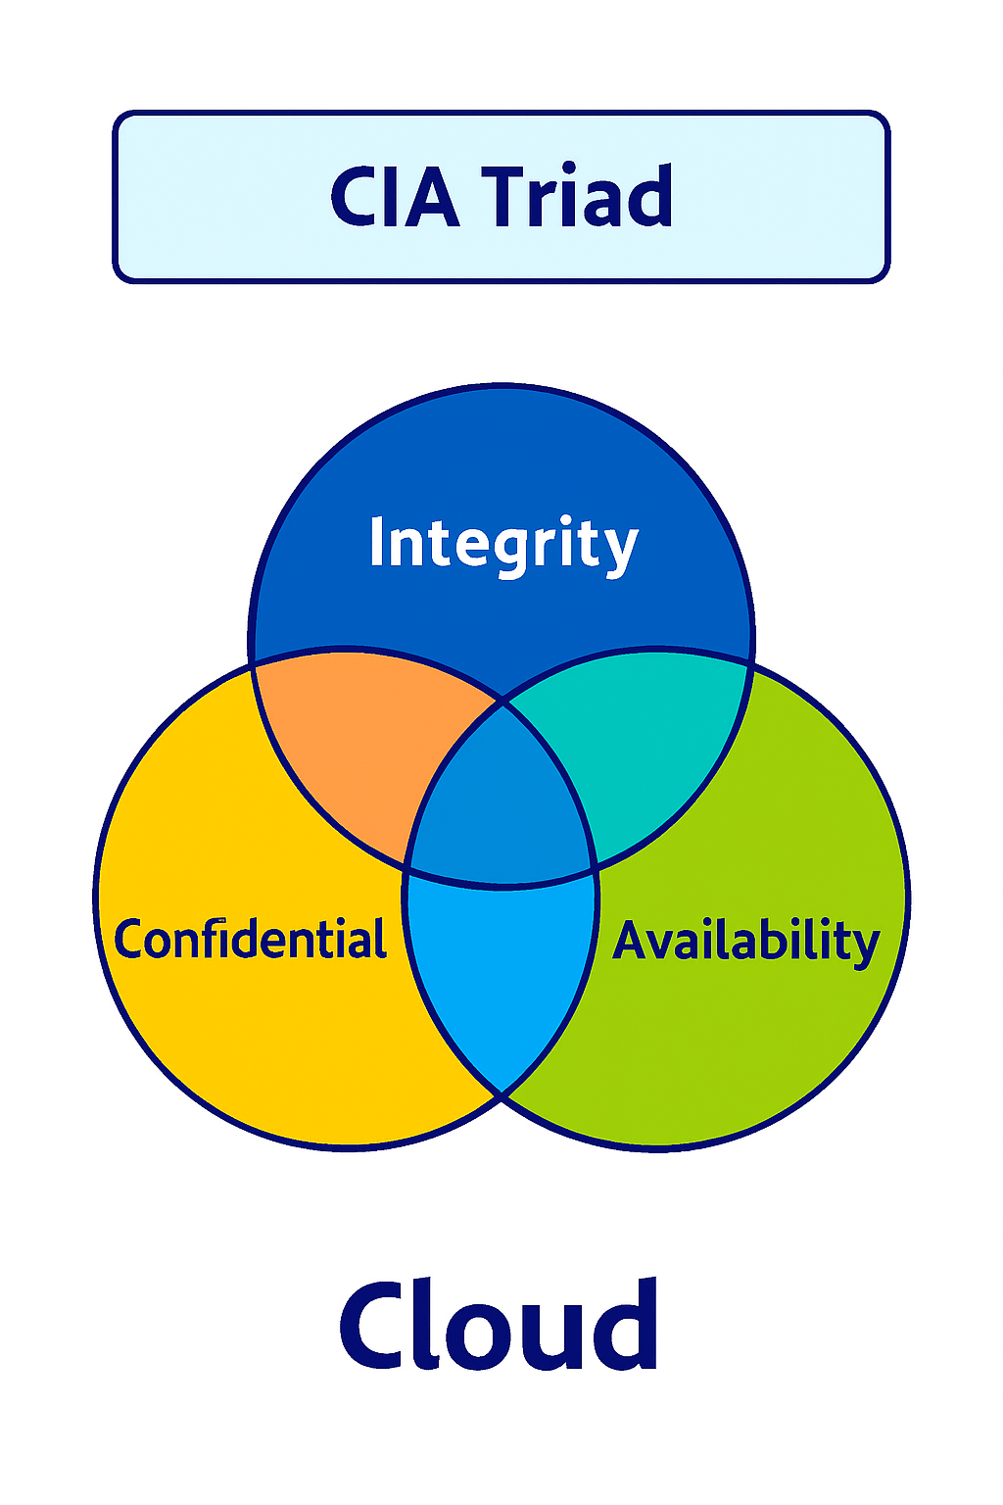
Cia triad
The CIA Triad is a foundational framework in information security, representing three core principles: Confidentiality, Integrity, and Availability.
The CIA triad is a commonly used model for the requirements of information security.
A weakness in any one of these pillars undermines the entire security posture. For example, encrypted data (confidentiality) is useless if corrupted (integrity) or inaccessible during downtime (availability).

Slide 28
confidentiality
Ensures that sensitive information is accessible only to authorized individuals or systems.
Goal: Prevent unauthorized access, leaks, or misuse of private data.
Threats: Insider leaks, weak passwords, outdated encryption, phishing attacks.
Mechanisms:
Encryption (e.g., AES, SSL/TLS) to protect data in transit and at rest.
Access controls (IAM, ACLs) to restrict who can view or modify data.
Data masking (e.g., hiding sensitive fields like SSNs).

Slide 29
Integrity
Ensures that data remains accurate, consistent, and trustworthy throughout its lifecycle.
Goal: Prevent unauthorized modifications or corruption of information.
Threats: Malware altering files, unauthorized edits, SQL injection attacks.
Mechanisms:
Hashing (e.g., SHA-256) to verify data integrity.
Digital signatures to authenticate source and content.
Version control systems (e.g., Git) to track changes.
Checksums and error detection codes for data transmission/storage.

Slide 30
Availability
Ensures that systems, applications, and data are accessible when needed by authorized users.
Goal: Prevent downtime and disruptions to critical services.
Threats: Hardware failures, cyberattacks (DDoS), natural disasters, misconfigurations.
Mechanisms:
Redundancy (load balancing, RAID, failover systems).
Disaster recovery plans and backups.
Anti-DDoS protections to mitigate denial-of-service attacks.
Regular system maintenance and patching.

Slide 31
ISMS and InfoSec
ISMS stands for Information Security Management System
An ISMS is a framework for managing information security risks across an organization.
It’s essentially the operational backbone of InfoSec, ensuring that policies, procedures, and controls are in place to protect data.
ISMS aligns with standards like ISO/IEC 27001, which formalizes best practices for confidentiality, integrity, and availability (the CIA triad).
ISMS is the management system that makes InfoSec practical and measurable.

Slide 32
GDPR and InfoSec
The General Data Protection Regulation (GDPR) is a landmark privacy and data protection law enacted by the European Union (EU) in 2016 and enforced from May 25, 2018.
It governs how organizations collect, process, store, and share personal data of individuals within the EU.
In 2018, the GDPR began requiring companies to:
provide data breach notifications
appoint a data-protection officer
require user consent for data processing
anonymize data for privacy

Slide 33
All companies operating within the EU must comply with these standards.
GDPR emphasizes principles like confidentiality, integrity, and accountability, which overlap directly with InfoSec.
Non-compliance can lead to heavy fines, so GDPR acts as a driver for InfoSec adoption.

Slide 34
Types of infosec
Application security
Cloud security
Cryptography
Infrastructure security
Incident response
Vulnerability management
Network Security
Physical Security
Operational & Organizational Security
Data/Information Security

Slide 35
Application Security
Secures software applications from vulnerabilities and exploits.
Involves secure coding practices, penetration testing, and patch management.
Goal: Prevent attacks like SQL injection, cross-site scripting, and buffer overflows.

Slide 36
Cloud security
Cloud security adapts protections to modern cloud environments. Together, they form a layered defense strategy.
Protects data, applications, and services hosted in cloud environments.
Involves identity management, encryption, and compliance with cloud-specific standards.

Slide 37
Cryptography
Encrypting data in transit and data at rest helps ensure data confidentiality and integrity.
Digital signatures are commonly used in cryptography to validate the authenticity of data.
Cryptography and encryption has become increasingly important.
A good example of cryptography use is the Advanced Encryption Standard (AES).
The AES is a symmetric key algorithm used to protect classified government information.

Slide 38
Infrastructure security
Infrastructure security deals with the protection of internal and extranet networks, labs, data centers, servers, desktops, and mobile devices

Slide 39
Incident response
Incident response is the function that monitors for and investigates potentially malicious behavior.
In preparation for breaches, IT staff should have an incident response plan for containing the threat and restoring the network.
In addition, the plan should create a system to preserve evidence for forensic analysis and potential prosecution.
This data can help prevent further breaches and help staff discover the attacker.

Slide 40
Vulnerability management
Vulnerability management is the process of scanning an environment for weak points (such as unpatched software) and prioritizing remediation based on risk.
In many networks, businesses are constantly adding applications, users, infrastructure, and so on.
For this reason, it is important to constantly scan the network for potential vulnerabilities.
Finding a vulnerability in advance can save your businesses the catastrophic costs of a breach.

Slide 41
Network Security
Protects data during transmission across networks.
Involves firewalls, intrusion detection/prevention systems, VPNs, and secure protocols.
Goal: Prevent unauthorized access, attacks like man-in-the-middle, and data leaks.

Slide 42
Physical Security
Protects physical IT assets such as servers, data centers, and hardware.
Includes locks, surveillance, biometric access, and disaster recovery planning.
Goal: Prevent theft, tampering, or damage to physical infrastructure.

Slide 43
Operational & Organizational Security
Involves policies, procedures, and governance frameworks.
Includes incident response, employee training, and compliance with standards (ISO 27001, NIST).
Goal: Ensure security is embedded in daily operations and organizational culture.

Slide 44
Data/information security
Focuses on safeguarding the data itself, whether stored or in transit.
Uses encryption, access controls, and data masking.
Goal: Ensure confidentiality, integrity, and availability of information.

Slide 45
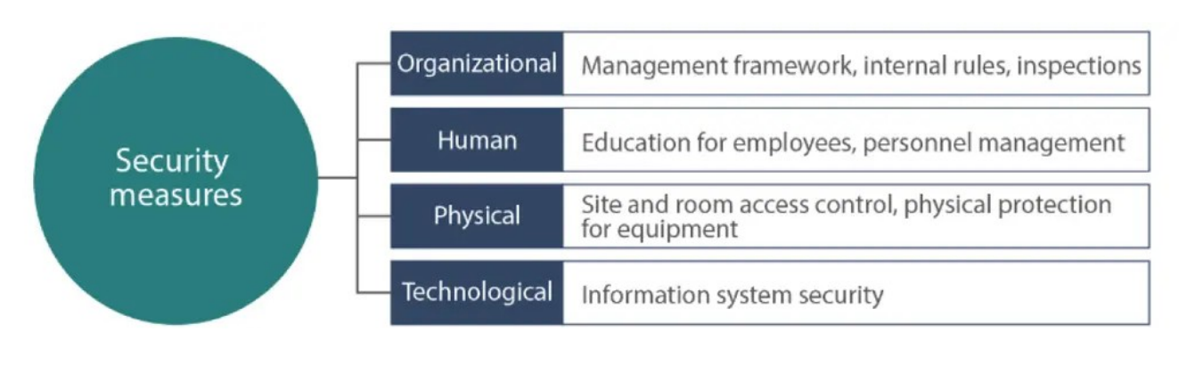
Information Security measures

Slide 46
Data protection law for information security in India
The Information Technology Act, 2000 (IT Act) and Indian Contract Act, 1872 are currently the data protection legislation in India

Slide 47
Cyber security
Cybersecurity is the practice of protecting computers, networks, systems, and data from digital attacks, unauthorized access, damage, or theft.
The NIST defines cybersecurity as protecting, preventing damage to and restoring electronic communications services and systems.
This includes the information stored in these systems, which cybersecurity professionals work to protect.
Cybersecurity covers everything that has to do with electronic systems and communications.
Within the field of cybersecurity are subcategories that include cloud, network, and critical infrastructure security.

Slide 48
Cyber security protects against
Hacking – Unauthorized access to systems
Malware – Viruses, ransomware, spyware
Phishing – Fake emails/messages that steal information
Data breaches – Exposure of sensitive data
Identity theft – Stealing personal information

Slide 49
Main Areas of Cybersecurity
Network Security – Protecting internal networks from intruders
Application Security – Securing software and apps from vulnerabilities
Information Security (InfoSec) – Protecting data privacy and integrity
Cloud Security – Securing cloud-based platforms and services
Endpoint Security – Protecting devices like laptops and phones
Ethical Hacking (Penetration Testing) – Testing systems to find weaknesses

Slide 50
Cyber security vs infosec
Cybersecurity and Information Security are closely related — but they’re not the same.
Information Security (InfoSec) protects all information, no matter the format.
Cybersecurity protects digital systems and data from cyber threats.
Information Security
Cybersecurity
Broader discipline | Subset of InfoSec
Protects all forms of information | Protects digital systems & data
Includes physical & administrative controls | Focuses mainly on technical controls
Covers governance, risk & compliance | Covers network, endpoint & cloud security

Slide 51
Ethical Hacking
Ethical hacking involves an authorized attempt to gain unauthorized access to a computer system, application, or data.
Carrying out an ethical hack involves duplicating strategies and actions of malicious attackers.
This practice helps to identify security vulnerabilities which can then be resolved before a malicious attacker has the opportunity to exploit them.

Slide 52
known as “white hats,” ethical hackers are security experts that perform these security assessments.
The proactive work they do helps to improve an organization’s security posture.
With prior approval from the organization or owner of the IT asset, the mission of ethical hacking is opposite from malicious hacking.

Slide 53
Key concepts of ethical hacking
Hacking experts follow four key protocol concepts:
Stay legal. Obtain proper approval before accessing and performing a security assessment.
Define the scope. Determine the scope of the assessment so that the ethical hacker’s work remains legal and within the organization’s approved boundaries.
Report vulnerabilities. Notify the organization of all vulnerabilities discovered during the assessment. Provide remediation advice for resolving these vulnerabilities.
Respect data sensitivity. Depending on the data sensitivity, ethical hackers may have to agree to a non-disclosure agreement, in addition to other terms and conditions required by the assessed organization.

Slide 54
How are ethical hackers different than malicious hackers?
Ethical hackers use their knowledge to secure and improve the technology of organizations.
They provide an essential service to these organizations by looking for vulnerabilities that can lead to a security breach.
An ethical hacker reports the identified vulnerabilities to the organization.
Additionally, they provide remediation advice.
In many cases, with the organization’s consent, the ethical hacker performs a re-test to ensure the vulnerabilities are fully resolved.

Slide 55
Malicious hackers intend to gain unauthorized access to a resource (the more sensitive the better) for financial gain or personal recognition.
Some malicious hackers deface websites or crash backend servers for fun, reputation damage, or to cause financial loss.
The methods used and vulnerabilities found remain unreported.
They aren’t concerned with improving the organizations security posture.

Slide 56
Skills and certifications an ethical hacker should obtain
All ethical hackers should have:
Expertise in scripting languages.
Proficiency in operating systems.
A thorough knowledge of networking.
A solid foundation in the principles of information security.
Some of the most well-known and acquired certifications include:
EC Council: Certified Ethical Hacking Certification
Offensive Security Certified Professional (OSCP) Certification
CompTIA Security+
Cisco’s CCNA Security, etc

Slide 57
Problems that does hacking identify.
While assessing the security of an organization’s IT asset(s), ethical hacking aims to mimic an attacker.
Once the ethical hacker gathers enough information, they use it to look for vulnerabilities against the asset. They perform this assessment with a combination of automated and manual testing.
Even sophisticated systems may have complex countermeasure technologies which may be vulnerable.
They don’t stop at uncovering vulnerabilities. Ethical hackers use exploits against the vulnerabilities to prove how a malicious attacker could exploit it.

Slide 58
Some of the most common vulnerabilities discovered by ethical hackers include:
Injection attacks
Broken authentication
Security misconfigurations
Use of components with known vulnerabilities
Sensitive data exposure
After the testing period, ethical hackers prepare a detailed report.
This documentation includes steps to compromise the discovered vulnerabilities and steps to patch or mitigate them.

Slide 59
Limitations of ethical hacking
Limited scope -Ethical hackers cannot progress beyond a defined scope to make an attack successful. However, it’s not unreasonable to discuss out of scope attack potential with the organization.
Resource constraints- Malicious hackers don’t have time constraints that ethical hackers often face. Computing power and budget are additional constraints of ethical hackers.
Restricted methods- Some organizations ask experts to avoid test cases that lead the servers to crash (e.g., Denial of Service (DoS) attacks).

Slide 60
Service Development life cycle
The Service Development Lifecycle (SDL) is a structured framework that ensures IT services are designed, delivered, and continuously improved to meet business needs.
It typically follows the ITIL model with five stages: Service Strategy, Service Design, Service
ITIL (Information Technology Infrastructure Library) is the world’s most widely adopted framework for IT Service Management (ITSM), providing best practices to align IT services with business needs.
The latest version, ITIL 4, emphasizes agility, DevOps, and digital transformation. Transition, Service Operation, and Continual Service Improvement.

Slide 61
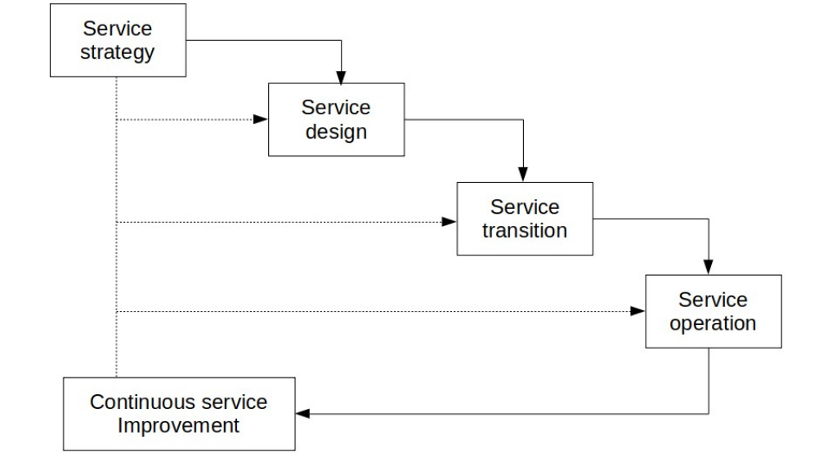
Stages of the Service Development Lifecycle

Slide 62
The Five Stages of the Service Development Lifecycle (ITIL Framework)
1. Service Strategy
Goal: Define the business objectives and align IT services with organizational goals.
Key Activities:
Market analysis and demand management
Financial management for services
Service portfolio management
Outcome: A clear strategy that ensures services deliver business value.

Slide 63
2. Service Design
Goal: Design services that meet business requirements and are cost-effective.
Key Activities:
Service catalog design
Capacity, availability, and continuity planning
Security and compliance considerations
Outcome: Detailed service designs, including processes, technologies, and metrics.

Slide 64
3. Service Transition
Goal: Move services from design into live operation smoothly.
Key Activities:
Change management
Release and deployment management
Knowledge management
Outcome: Services are tested, validated, and deployed with minimal disruption.

Slide 65
4. Service Operation
Goal: Ensure services are delivered effectively and efficiently.
Key Activities:
Incident management (resolving issues quickly)
Problem management (preventing recurring issues)
Event and access management
Outcome: Stable, reliable service delivery with continuous monitoring.

Slide 66
5. Continual Service Improvement (CSI)
Goal: Identify opportunities to improve services and processes.
Key Activities:
Performance measurement and reporting
Root cause analysis of failures
Implementing improvements based on feedback
Outcome: Services evolve to remain aligned with changing business needs.

Slide 67
Security development lifecycle
The Security Development Lifecycle (SDL) is a structured process that integrates security into every phase of software development, ensuring vulnerabilities are identified and mitigated early rather than after deployment.
It is widely used by organizations (notably Microsoft) to embed security into DevOps and modern software practices.
Scope: Applies to all development models—waterfall, agile, DevOps.

Slide 68
What are the Microsoft SDL practices?
Provide Training - Ensure everyone understands security best practices.
Define Security Requirements - Continually update security requirements to reflect changes in functionality and to the regulatory and threat landscape.
Define Metrics and Compliance Reporting-Identify the minimum acceptable levels of security quality and how engineering teams will be held accountable.
Perform Threat Modeling- Use threat modeling to identify security vulnerabilities, determine risk, and identify mitigations.
Establish Design Requirements- Define standard security features that all engineers should use.

Slide 69
6) Define and Use Cryptography Standards -Ensure the right cryptographic solutions are used to protect data.
7) Manage the Security Risk of Using Third-Party Components- Keep an inventory of third-party components and create a plan to evaluate reported vulnerabilities.
8) Use Approved Tools-Define and publish a list of approved tools and their associated security checks.
9) Perform Static Analysis Security Testing (SAST)-Analyze source code before compiling to validate the use of secure coding policies.

Slide 70
10)Perform Dynamic Analysis Security Testing (DAST)-Perform run-time verification of fully compiled software to test security of fully integrated and running code.
11)Perform Penetration Testing- Uncover potential vulnerabilities resulting from coding errors, system configuration faults, or other operational deployment weaknesses.
12)Establish a Standard Incident Response Process- Prepare an Incident Response Plan to address new threats that can emerge over time.

Slide 71
Threat modeling in sdl
Threat modeling is a core activity within the Security Development Lifecycle (SDL).
It provides a structured way to identify and mitigate risks early in the design phase, ensuring that security is built into software rather than bolted on later.
SDL uses threat modeling to anticipate attacker behavior, prioritize vulnerabilities, and guide secure design decisions.

Slide 72
threat modeling process
Steps involved in threat modeling include:
1) Identify assets. An asset could be account data, intellectual property, or simply the reliable functioning of a system.
2) Diagram the system. DFDs provide a high-level, asset-centric view of systems and the data flows of attacks. An attack tree, or graphic representation of an attack path, illustrates the possible origins and paths of attacks.
3) Analyze threats. Use threat modeling methods to further analyze specific threat types, identify potential threats, map data flows, and quantify risk.

Slide 73
4) Perform risk management and prioritization. Many threat modeling tools produce threat scores and data for calculating risk. Stakeholder input is essential to this step.
5) Identify fixes. Once identified the areas, assets, or threats that matter most to the organization, Changing firewall, encryption, or multi-factor authentication settings are examples of steps to address a threat

Slide 74
Effectiveness of threat modeling
Two ways to measure effectiveness are:
Common Vulnerability Scoring System (CVSS). CVSS produces standardized scores for application vulnerabilities, IT systems and elements, and IoT devices; the scores can be calculated with a free online tool.
Penetration testing. Sometimes referred to as "ethical hacking," penetration testing is the process of staging dummy attacks on a system to measure its strengths and weaknesses. Pen tests may require a good deal of time-consuming data analysis.

Slide 75
Threat modeling methods and tools
CIA method –
use the CIA (confidentiality, integrity, availability) method to define what needs protecting in the organization.
For example, there may be sensitive customer information (confidentiality), company operational or proprietary data (integrity), or reliability of a service such as a web portal (availability).
Attack trees
Attack trees are a graphic representation of systems and possible vulnerabilities.
The trunk of the attack tree is the asset, while entry points and threats are branches or roots.

Slide 76
STRIDE
Developed by Microsoft, STRIDE is spoofing, tampering, repudiation, information disclosure, denial of service, elevation of privilege.
STRIDE is a free tool that will produce DFDs and analyze threats.
PASTA
PASTA (process for attack simulation and threat analysis) is a framework designed to elevate threat modeling to the strategic level, with input from all stakeholders, not just IT or security teams.
PASTA is a seven-step process that begins with defining objectives and scope.
It includes vulnerability checks, weakness analysis, and attack modeling, and ends with risk and impact analysis expressed through scoring

Slide 77
Trike
An open-source tool available as a spreadsheet template or standalone program,
Trike consists of a matrix combining assets, actors, actions, and rules.
When parameters and data are entered in this matrix, the program produces a score-based analysis of risks and probabilities.
VAST
VAST (visual, agile, and simple threat) modeling consists of methods and processes that can be easily scaled and adapted to any scope or part of an organization.
The results produce benchmarks that can be used to make reliable comparisons and measurements of effective risk across a whole organization.

Slide 78
Risk Management
Any factor or threat that might adversely affect the successful completion of the project is a risk.
With risk management, we can monitor all the risks that are associated with a project.
Create a risk item record.
A risk item record is a single item that defines a project liability.

Slide 79
In a risk item record, specify the risk item, the resolution of the risk, and also the approver that the record is sent to.
If there are multiple risk item records, group them together in a risk item review record.
By efficiently managing risks, we can increase the chance of project success and identify, address, and eliminate risks before they become threats to the growth of the project.

Slide 80
The objectives of DevOps: - frequent deployment, - faster delivery time to market, - accelerated innovation, - reduced failure rates and - better recovery time.
DevOps brings excellent benefits to an organisation, increases operational efficiency and supports better delivery of services to consumers.

Slide 81
Apart from advantages, DevOps also increases organisations' exposure to a range of technology risks, including cyber risks.
Other challenges are
lack of code quality because developers are unfamiliar with QA and roadblocks in operations
the absence of alignment between projects,  DevOps and risk management goals,
the lack of fully automated risk characterisation, monitoring, and mitigation.

Slide 82
Benefits of DevOps may be undermined by a lack of an intuitive approach to risks and design of controls.
The three objectives to achieve with DevRiskOps are:
To better understand DevOps utilisations focusing on risk and delivery optimisation.
To provide stakeholder insight into the environment at both a technical and granular level, supporting the requirement to demonstrate risks at each level throughout the organisation.
To maintain a basis to continuously improve the ecosystem with risks pertinent to the organisation at the forefront of the process.

Slide 83
DevRiskOps approach
DevRiskOps is an approach that integrates Development, Risk Management, and Operations into one continuous process to build services that are functional, secure, and compliant from the start. It is similar to DevOps, but with strong focus on risk, security, and compliance, often used in cybersecurity and InfoSec environments.
DevRiskOps is commonly aligned with frameworks like
DevOps
ISO/IEC 27001
NIST Cybersecurity Framework
ITIL

Slide 84
Risk practitioners should consider the following when developing their approach:
1) Define the scope of the DevOps strategy.
2) Identify the DevOps functions and domain.
3) Clearly understand the risks in the DevOps domain and map them to the controls.
4) Ensure controls are correlated to the various stages in CI/CD pipelines.
5) Identify all relevant stakeholders.

Slide 85
6) Have an adequate automation process with a comprehensive toolchain and adequate metrics.
7) Work towards capability, not pure maturity.
The support of DevOps risk management objectives by walking alongside DevOps means starting small with a repetitive process, iterative automation, and continuous feedback.
It also helps with the establishment and simplification of the software acquisition process.

